Slide 1
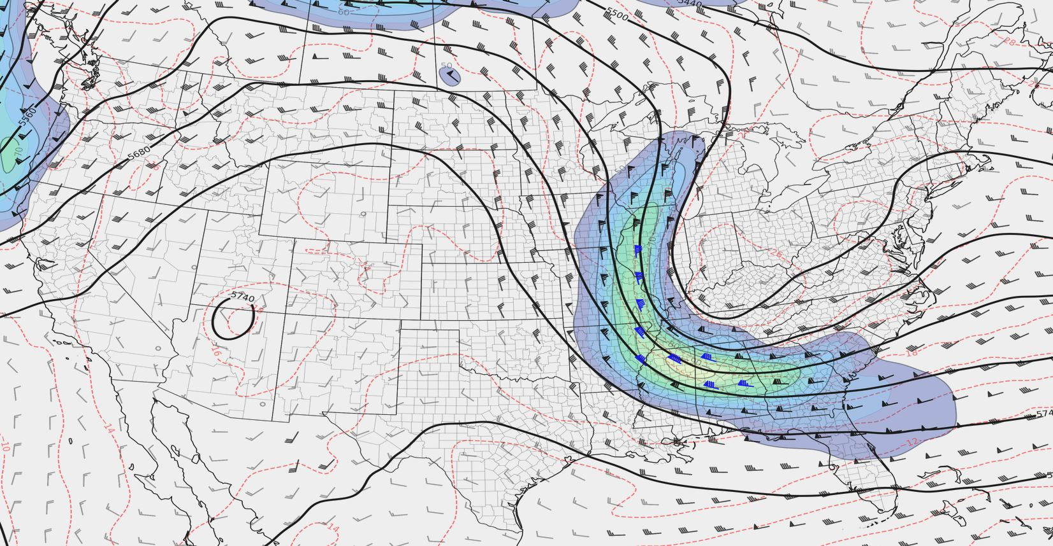
QG Height Tendency
Arranged by Andrew Moore
Material from Thomas Galarneau

Slide 2
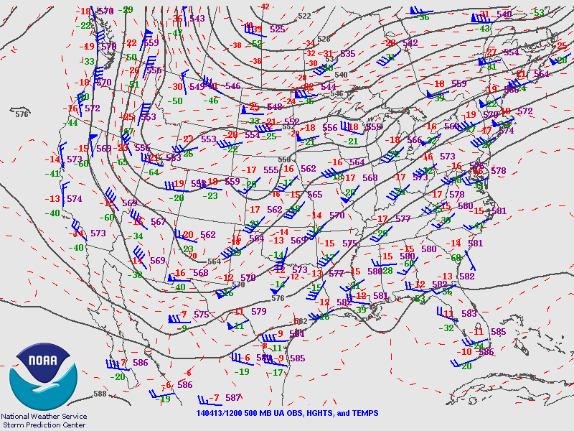
QG Height Tendency
Why do we care?
The QG height tendency equation allows us to anticipate:
The evolution of upper air and surface patterns
The evolution of certain severe weather parameters (e.g. shear, lift, etc…)
It is also relatively easy to use!
What will this pattern look like in 12-24 hours?

Slide 3
QG Height Tendency
A quick note:
There are alternatives to QG theory (for example, IPV theory), that will work just as well.
We will focus on QG theory in this class for two reasons:
It’s easy to interpret from basic weather charts
Most U.S. weather entities use QG theory (not the case elsewhere…)
What will this pattern look like in 12-24 hours?

Slide 4
Some Background Concepts
Mass Continuity:
We’re going to assume:
On synoptic scales, the troposphere is incompressible.
Hydrostatic approximation applies
Vertical velocity is zero at the surface and at the tropopause.
Because of mass continuity, any vertical motion is associated with horizontal convergence and divergence
W = 0
Divergence
>
w < 0
Level of Non-Divergence
<
<
Convergence
W = 0

Slide 5
Some Background Concepts

Slide 6
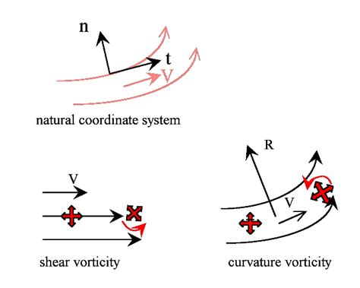
Some Background Concepts
Vorticity:
Vorticity is the curl of the wind field
Exists in all 3 dimensions, but for today we’ll only consider the X/Y dimensions
Vorticity can be generated by curvature in the flow and/or speed shear in the flow
Vorticity is directly related to vertical motions and convergence/divergence due to the conservation of angular momentum and conservation of mass

Slide 7
Physical Intuition
Charles’s Law
The volume of a gas is directly proportional to the temperature of the gas at a constant pressure.
If the gas heats up -> it expands!
If the gas cools down -> it contracts!

Slide 8
Physical Intuition
Consider a layer of the atmosphere in contact with the surface:
Warming the layer
Cooling the layer
Initial Height
Warming
Cooling
The ground can’t move - so the top of the layer must move!

Slide 9
Physical Intuition
Consider a layer of the atmosphere in contact with the surface:
Warming the layer
Cooling the layer
Final Height
Initial Height
(Expands)
Final Height
(Contracts)
The ground can’t move - so the top of the layer must move!

Slide 10
Physical Intuition
Consider a layer of the atmosphere above the surface:
Warming the layer
Cooling the layer
Initial Height 1
Warming
Cooling
Initial Height 2

Slide 11
Physical Intuition
Consider a layer of the atmosphere above the surface:
Warming the layer
Cooling the layer
Final Height 1
Initial Height 1
Final Height 1
(Expands)
(Contracts)
Final Height 2
Initial Height 2
Final Height 2

Slide 12
Physical Intuition
Geostrophic Vorticity:
Plug in geostrophic wind balance into the vorticity equation.
You end up with a form of geostrophic vorticity that relates to the Laplacian of the geopotential height field.
Thus, if you locally change the vorticity at a location, you must also change the geopotential height (i.e. thickness) field!
Consider this geopotential height field. What would vorticity look like?
y
+ 4
x

Slide 13
Physical Intuition
Geostrophic Vorticity:
Plug in geostrophic wind balance into the vorticity equation.
You end up with a form of geostrophic vorticity that relates to the Laplacian of the geopotential height field.
Thus, if you locally change the vorticity at a location, you must also change the geopotential height (i.e. thickness) field!
Consider this geopotential height field. What would vorticity look like?
y
+ 4
Positive
Vorticity
Negative
Vorticity
x
Use the thermal wind relation to confirm!

Slide 14
Physical Intuition
Geostrophic Vorticity:
Plug in geostrophic wind balance into the vorticity equation.
You end up with a form of geostrophic vorticity that relates to the Laplacian of the geopotential height field.
Thus, if you locally change the vorticity at a location, you must also change the geopotential height (i.e. thickness) field!
Consider this geopotential height field. What would vorticity look like?
y
+ 4
x
If we change the geopotential height field, how will the vorticity field change (and vise versa)?

Slide 15
QG Vorticity and Thermo Equations
QG vorticity equation
Rate of change of absolute vorticity
Vertical motion
(or convergence/divergence)
See Bluestein Vol. 1 page 329 for details
QG thermodynamic equation
Vertical motion
(or expansion/contraction from vertical motion)
Rate of change of temperature

Slide 16
QG Height Tendency Equation
Differential thermal
advection
2nd derivative operator
Absolute vorticity advection
Diabatic heating

Slide 17
QG X Breakdown
2nd Derivative Operator:
On synoptic scales, we can roughly assume that the height field (and thus the height tendency field) is sinusoidal.
Take the second derivative of a sine function:
d(d(sin(x)))
= d(cos(x))
= -sin(x)
This assumption turns the 2nd derivative operation into a simple minus sign!

Slide 18
QG X Breakdown
OR
Consider this case:
Advection of absolute vorticity:
This considers both relative vorticity (related to the height field) and planetary vorticity (related to the Coriolis force).
Here we see how moving the height field (more specifically, the Laplacian of the height field) can change the height field.
Vorticity Maximum
X
Vg = 0
Ug > 0

Slide 19
QG X Breakdown
OR
Consider this case:
Advection of absolute vorticity:
Advecting cyclonic vorticity (CVA) leads to height falls
Advecting anticyclonic vorticity (AVA) leads to height rises
Vorticity Maximum
X
Vg = 0
Ug > 0

Slide 20
QG X Breakdown
OR
Differential Thermal Advection
Assume:
Vg > 0
Ug = 0
P = 1000 mb
P = 925 mb
P = 850 mb
y
y
y
z
T - 2
T - 2
T - 2
Z 850
T - 1
T - 1
T
T - 1
Z 920
T + 1
T
T + 2
T
Z 1000
x
x
x
x

Slide 21
QG X Breakdown
OR
Differential Thermal Advection
Assume:
Vg > 0
Ug = 0
Consider only y component of thermal advection:
P = 1000 mb
y
Vg > 0
dT/dy < 0
-Vg(dT/dy) > 0
T - 2
T - 1
T
x
x

Slide 22
QG X Breakdown
OR
Differential Thermal Advection
Assume:
Vg > 0
Ug = 0
Consider only y component of thermal advection:
P = 925 mb
y
Vg > 0
dT/dy << 0
-Vg(dT/dy) >> 0
T - 2
T - 1
T
T + 1
T + 2
x

Slide 23
QG X Breakdown
OR
Differential Thermal Advection
Assume:
Vg > 0
Ug = 0
Consider only y component of thermal advection:
P = 850 mb
y
Vg > 0
dT/dy < 0
-Vg(dT/dy) > 0
T - 2
T - 1
T
x

Slide 24
QG X Breakdown
OR
Can’t forget this -1!
Differential Thermal Advection
Now consider differential portion between the pressure levels:
z
Between 850 - 925:
d(Tadv)/dP > 0
-1 * (positive value) = positive value
Z 850
Z 920
Between 925 - 1000:
d(Tadv)/dP < 0
Z 1000
-1 * (negative value) = negative value

Slide 25
QG X Breakdown
OR
Differential Thermal Advection
Now consider differential portion between the pressure levels:
z
Between 850 - 925:
Positive Value = Height Rises!
Z 850
Z 850
Z 920
Z 920
Between 925 - 1000:
Negative Value = Height Falls!
Z 1000
Z 1000

Slide 26
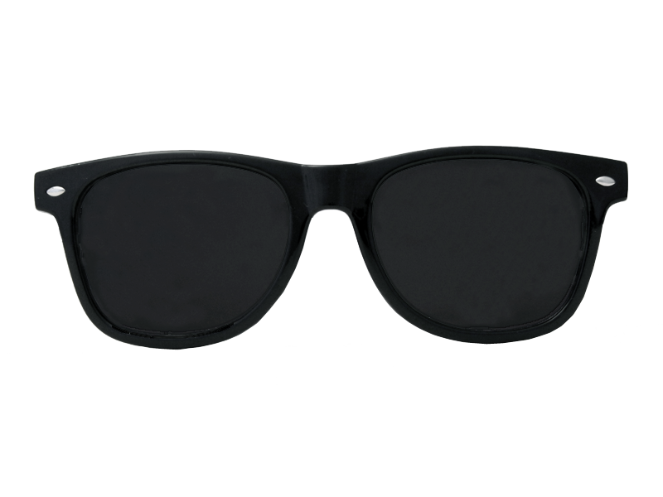
QG X Breakdown
OR
Differential Thermal Advection:
Warm air advection at a given pressure level induces height rises above that level, and height falls below that level
Cold air advection does the opposite: it cases height falls above the given pressure level, and height rises below.
This ties back directly to Charles’s Law!

Slide 27
QG X Breakdown
Diabatic Heating:
Similar in concept to differential thermal advection:
Diabatic heating in a layer causes the layer to expand;
Diabatic cooling in layer causes the layer to contract.
Causes height rises (falls) above (below) the source of heating.
Causes height rises (falls) below (above) the source of cooling
Examples:
Latent heat release from large systems (hurricanes, large cyclones, etc…)
Mesohighs in the wake of strong MCSs

Slide 28
QG X Breakdown
Warming the layer
Cooling the layer
Final Height 1
Initial Height 1
Final Height 1
Heating source
Cooling source
Final Height 2
Initial Height 2
Final Height 2

Slide 29
QG X Application
How do we use this?
Use the vorticity advection term to help anticipate where a vorticity maximum or minimum (i.e. a trough or a ridge) will go.
Use the differential thermal advection term to anticipate whether or not a trough or ridge will amplify.
The diabatic heating term is similar to the thermal advection term, but is typically not as consequential.

Slide 30
QG X Application
Z - 3
Conceptual Model:
Shortwave propagating through longwave
Z - 2
Z - 1
Xmax
Z
Xmin
Vg

Slide 31
QG X Application
Z - 3
Conceptual Model:
Shortwave propagating through longwave
Z - 2
Z - 1
Xmax
Xmin
Z
Vg

Slide 32
QG X Application
Z - 3
Conceptual Model:
Shortwave propagating through longwave
Z - 2
Z - 1
Xmax
Xmin
Z
Vg

Slide 33
QG X Application
Z - 3
Conceptual Model:
Shortwave Amplifying Longwave
Z - 2
L
Z - 1
Z

Slide 34
QG X Application
Z - 3
Conceptual Model:
Shortwave Amplifying Longwave
Z - 2
L
Height rises aloft in cold advection regime
Height falls aloft in cold advection regime
Z - 1
Z

Slide 35
QG X Examples
Focus on the shortwave trough in New Mexico.
Where is the vorticity maximum at?
Where will the 500 mb winds advect this vort. max?

Slide 36
QG X Examples
Focus on the shortwave trough in New Mexico.
Where is the vorticity maximum at?
Where will the 500 mb winds advect this vort. max?
X

Slide 37
QG X Examples
How about this shortwave over the northern Great Basin?
Where is the vorticity maximum?
Where will the geostropshic winds advect the vorticity?
X

Slide 38
QG X Examples
How about this shortwave over the northern Great Basin?
Where is the vorticity maximum?
Where will the geostropshic winds advect the vorticity?
X
X

Slide 39
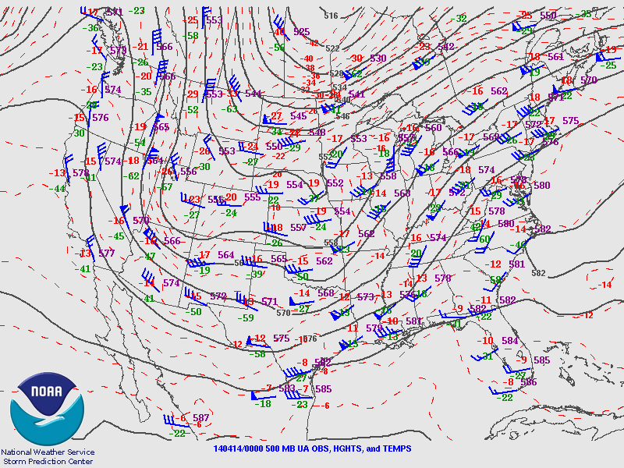
QG X Examples
Did this meet your expectations?
X
X

Slide 40
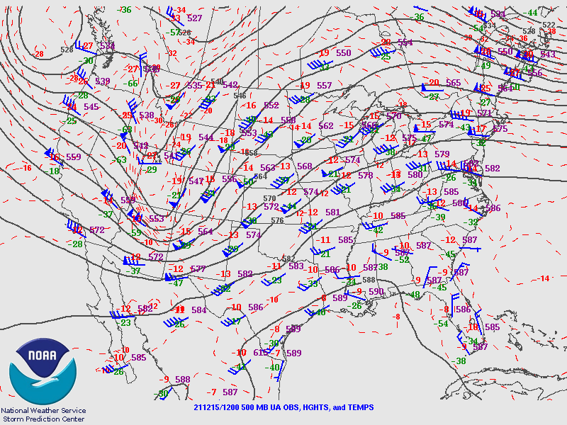
QG X Examples
How about this case?
Where do you think this trough will go in the next 12 hours?
(Choose A, B, C, or D)
A
X
B
C
D

Slide 41
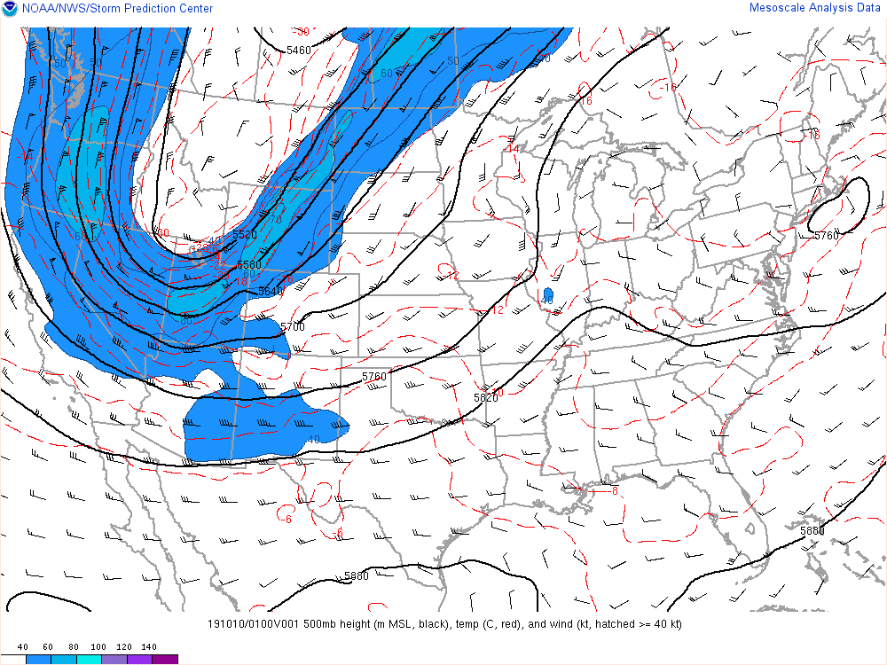
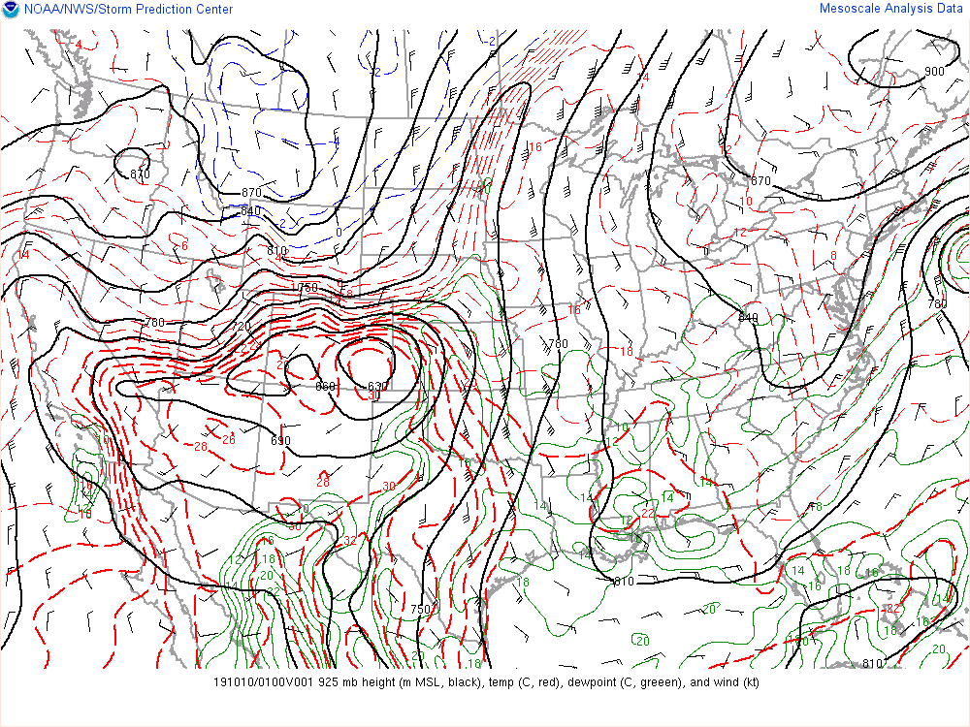
QG X Examples
Watch how the 500 mb trough deepens as the 925 mb cold front surges south into the Plains.
This is an example of differential thermal advection.

Slide 42
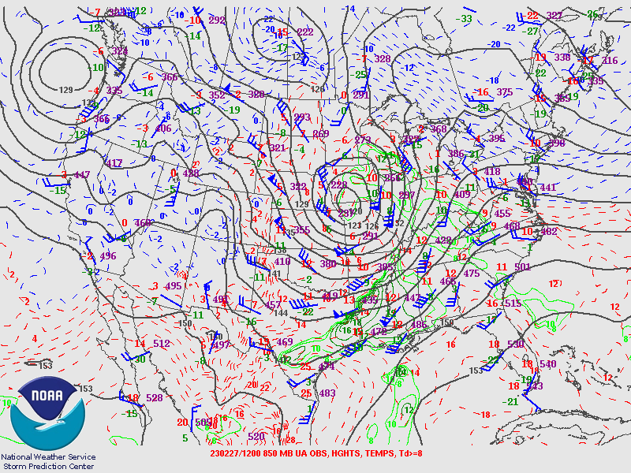
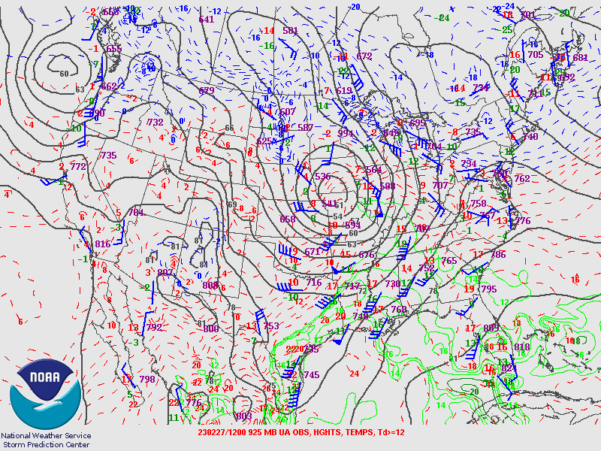
QG X Examples
Where is the strongest warm air advection at 850 mb?
This will tell you where the 925 mb low should go!

Slide 43
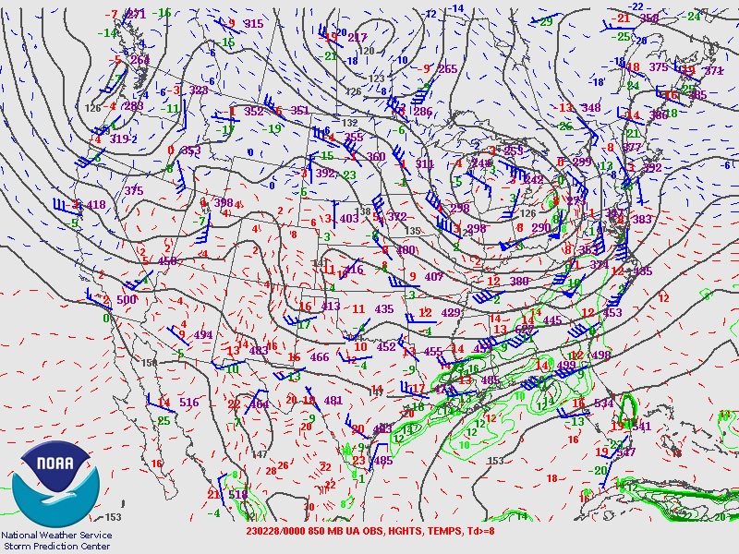
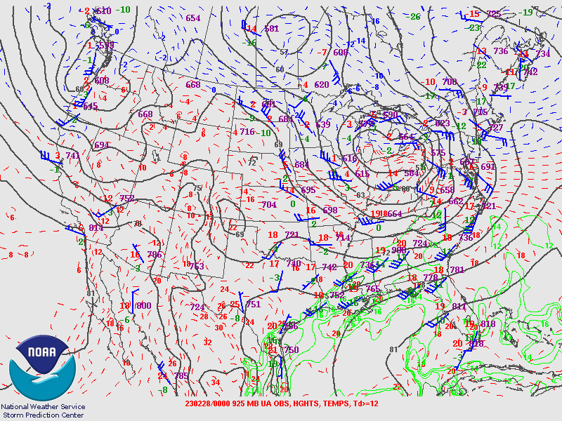
QG X Examples
Where is the strongest warm air advection at 850 mb?
This will tell you where the 925 mb low should go!

Slide 44
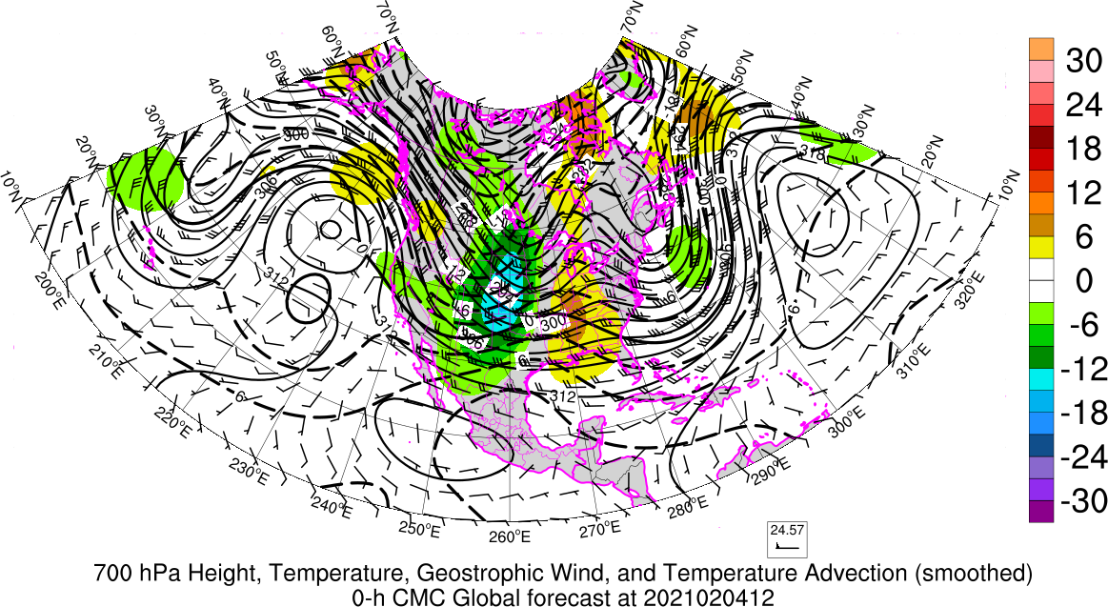
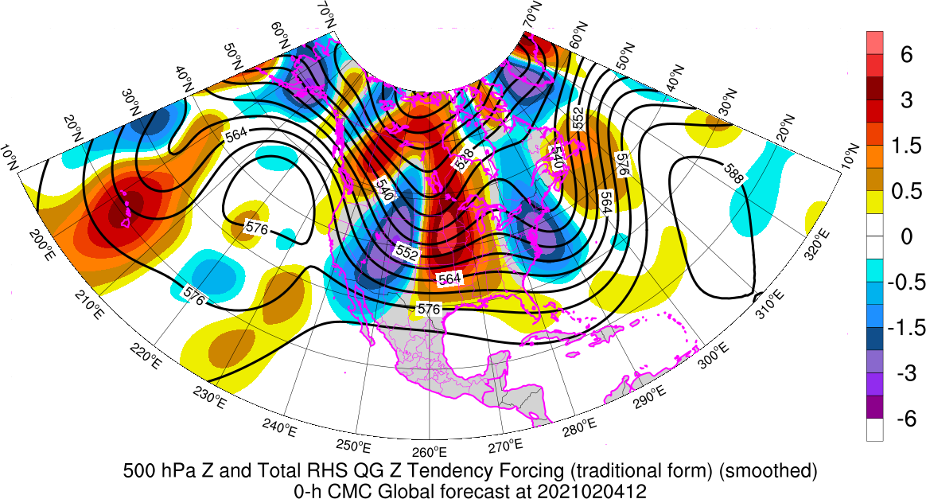
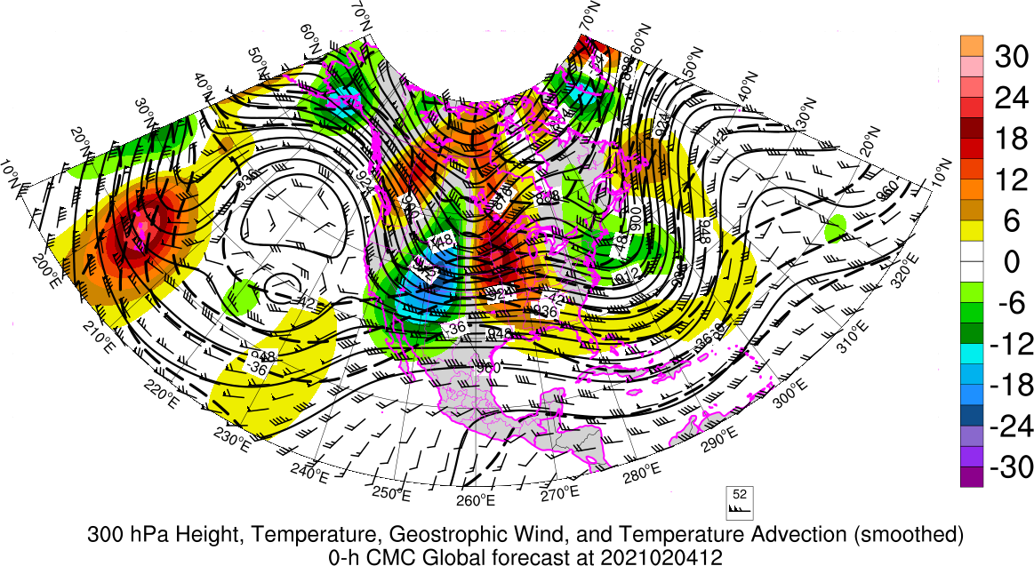
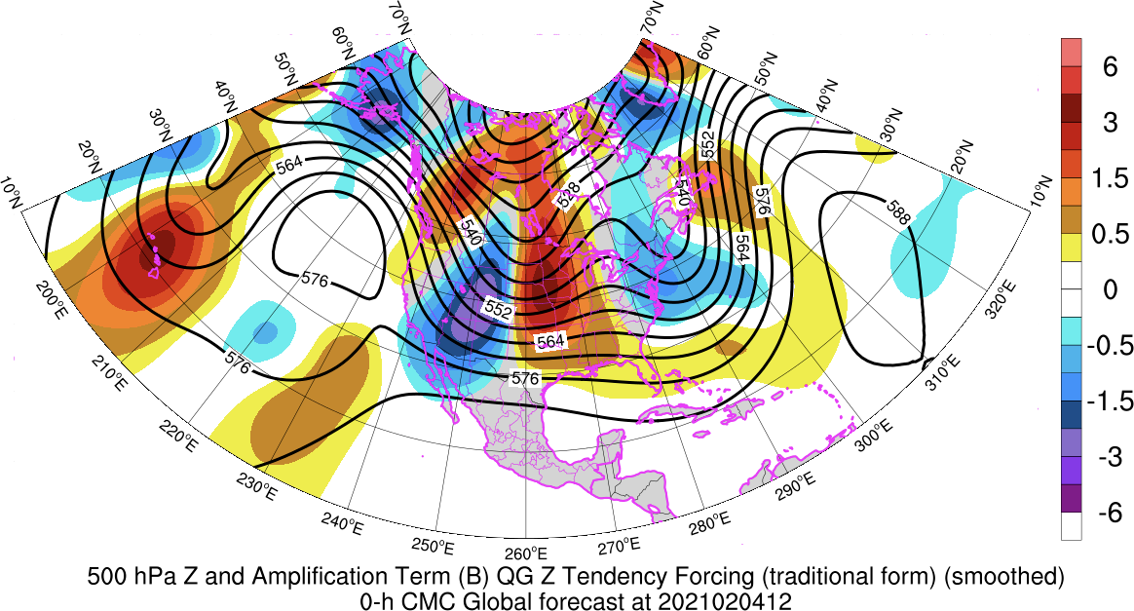
QG Resources
https://inside.nssl.noaa.gov/tgalarneau/real-time-qg-diagnostics/

